Slide 1
InsightHive (Crowdsourced Workforce Insights Platform)
A Crowdsourced Data Solution For Real-time Market Insights
Hasnain Sheikh (BSSE-1408)
Md. Rakibul Islam (BSSE – 1411)
Supervisor : Dr. Md. Shariful Islam
Professor
IIT, DU

Slide 2
Project Description
This project develops a mobile platform for gathering real-time insights from gig workers, enabling businesses to access market data from shops for better decision-making. It leverages crowdsourcing to track trends and feedback while offering gig workers flexible task opportunities.

Slide 3
Project Motivation
Tradition Market Research
Businesses struggle to access real-time, on-the-ground market data.
Traditional market research is expensive and slow.
Limited access to diverse data across multiple regions and markets.
Crowdsourced Platform
A crowdsourced platform where gig workers complete tasks and provide real-time insights.
Businesses gain direct access to actionable market data.
Flexible opportunities for gig workers, empowering them with work options.

Slide 4
Key Features
Registration & Profile Management
Task Management
Realtime Notifications and Verification
Report Submission
Performance Monitoring Dashboard
Incentive & Rating System

Slide 5
Benefits for Gig Workers
Flexible task opportunities based on location and availability.
Incentives and rewards for completing tasks.
Easy-to-use platform for submitting reports and earning ratings.
Direct communication with companies for task verification.
Business Benefits
Access to real-time, diverse market data.
Cost-effective solution for market research and trend analysis.
Scalable to different regions and markets.
Faster decision-making in marketing and product strategies.

Slide 6
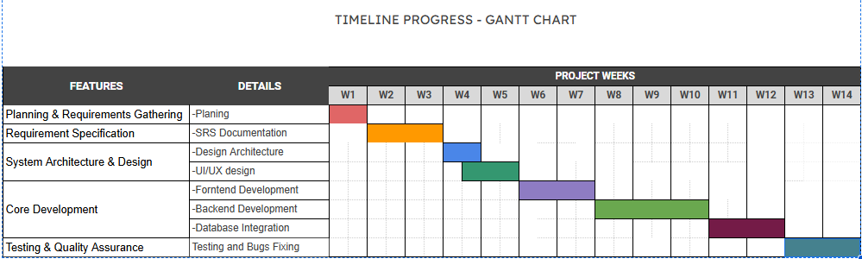

Slide 7
Languages or Tools To Be Used:
Frontend Development : Flutter, Dart
Backend & Database :Firebase Firestore, Firebase Authentication, Firebase Cloud Messaging (FCM)
Version Control & Collaboration : Git, GitHub, VS Code, Android Studio

Slide 8
Thank You

